Slide 1
Job Board application
By
1.Balcha Berhanu
2.Abusew Zemedkun

Slide 2



Web-Based Job Application Final Project
Welcome to the presentation showcasing the final project for our web-based job application platform. This project is a culmination of months of dedicated work, encompassing a range of cutting-edge technologies and best practices in web development. Join us as we delve into the intricacies of this project, exploring its key features, design principles, and the invaluable lessons we learned along the way.
by Balcha & Abusew

Slide 3

Project Overview and Objectives
The core objective of this project was to create a comprehensive and user-friendly web application that streamlines the entire job application process for both job seekers and employers. This ambitious undertaking involved a multitude of functionalities, including a robust user registration and authentication system, a flexible job posting management platform, and a seamless application submission and tracking mechanism. We aimed to deliver a platform that not only simplifies the hiring process but also enhances the overall experience for all stakeholders.
User-centric Design
Streamlined Process
Our primary focus was to prioritize the needs and expectations of both job seekers and employers, ensuring a smooth and intuitive experience for all users.
We aimed to optimize the job application process, making it efficient, transparent, and accessible to a wide range of users.
Comprehensive Functionality
The platform was designed to encompass all essential aspects of job application management, from posting and searching to application submission and tracking.

Slide 4
Technologies Used: React, JavaScript, HTML/CSS
The foundation of our web-based job application project rests on a powerful combination of modern web technologies. At its core lies React, a JavaScript library that empowers us to build dynamic and interactive user interfaces. React's component-based architecture enables us to create reusable and modular components, resulting in a more efficient and scalable development process.
React
JavaScript
HTML/CSS
The foundation of our frontend, React enabled us to build a dynamic and interactive user interface with reusable components.
JavaScript is the driving force behind the application's functionality, handling events, data manipulation, and interaction with the backend.
HTML provides the structural framework, while CSS defines the visual presentation and styling of the user interface.

Slide 5

Application Architecture and Design
The architecture of our job application platform reflects a robust and well-organized approach to software design. We adopted a layered architecture, dividing the application into distinct components that interact seamlessly to deliver a comprehensive user experience. This modularity allows for independent development and maintenance of each layer, facilitating scalability and adaptability in the long run.
1
Frontend
This layer handles user interaction, displaying data, and facilitating communication with the backend through API calls.
2
Backend
The backend serves as the core of the application, managing data storage, processing requests, and handling user authentication.
3
Database
The database securely stores all application data, including user profiles, job postings, and application submissions.
4
API
The API acts as an intermediary, enabling communication between the frontend and backend, ensuring smooth data exchange.

Slide 6

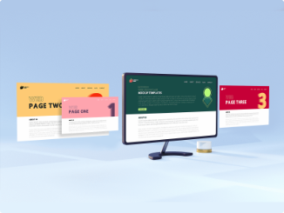
User Interface and User Experience
The user interface (UI) and user experience (UX) of our job application platform were meticulously designed to provide a seamless and engaging experience for all users. Our UI adheres to principles of accessibility and usability, ensuring a comfortable and intuitive navigation for users with diverse needs and abilities. We employed a clean and modern design aesthetic, prioritizing visual clarity and intuitive layout.
1
Responsive Design
2
Intuitive Navigation
The UI adapts seamlessly to different screen sizes, ensuring a consistent and optimized experience across various devices.
A clear and logical navigation structure guides users through the platform efficiently, making it easy to find what they need.
3
Visual Clarity
4
User Feedback
The UI employs a clean and uncluttered layout, using clear typography, appropriate color schemes, and consistent visual elements for optimal readability and comprehension.
We incorporated user feedback throughout the development process, iteratively refining the UI and UX based on real-world insights.

Slide 7

Data Management and State Handling
Data management and state handling are critical components of any web application, especially one as complex as a job application platform. We implemented robust strategies to ensure data integrity, consistency, and efficient management of application state. Our data management approach ensures data is stored securely and accessed efficiently.
Data Storage
We selected a relational database system to manage our application data, ensuring data integrity and efficient retrieval.
State Management
We employed a state management library, allowing for efficient management of application state, enhancing performance and responsiveness.
Data Validation
We implemented robust validation mechanisms to ensure data consistency and accuracy, preventing errors and improving data quality.

Slide 8




Form Validation and Error Handling
Form validation and error handling are crucial aspects of user experience in a job application platform. Our approach ensures that user inputs are validated in real-time, providing immediate feedback and preventing potential errors. This proactive approach eliminates frustration and ensures data accuracy, contributing to a smooth and efficient application process.
Client-Side Validation
Server-Side Validation
Error Handling
We integrated validation rules directly into the frontend, providing real-time feedback to users as they fill out forms.
Additional validation checks are performed on the server-side, ensuring data integrity and security before it's stored in the database.
Comprehensive error handling mechanisms are implemented to gracefully handle unexpected errors and provide informative messages to users.

Slide 9

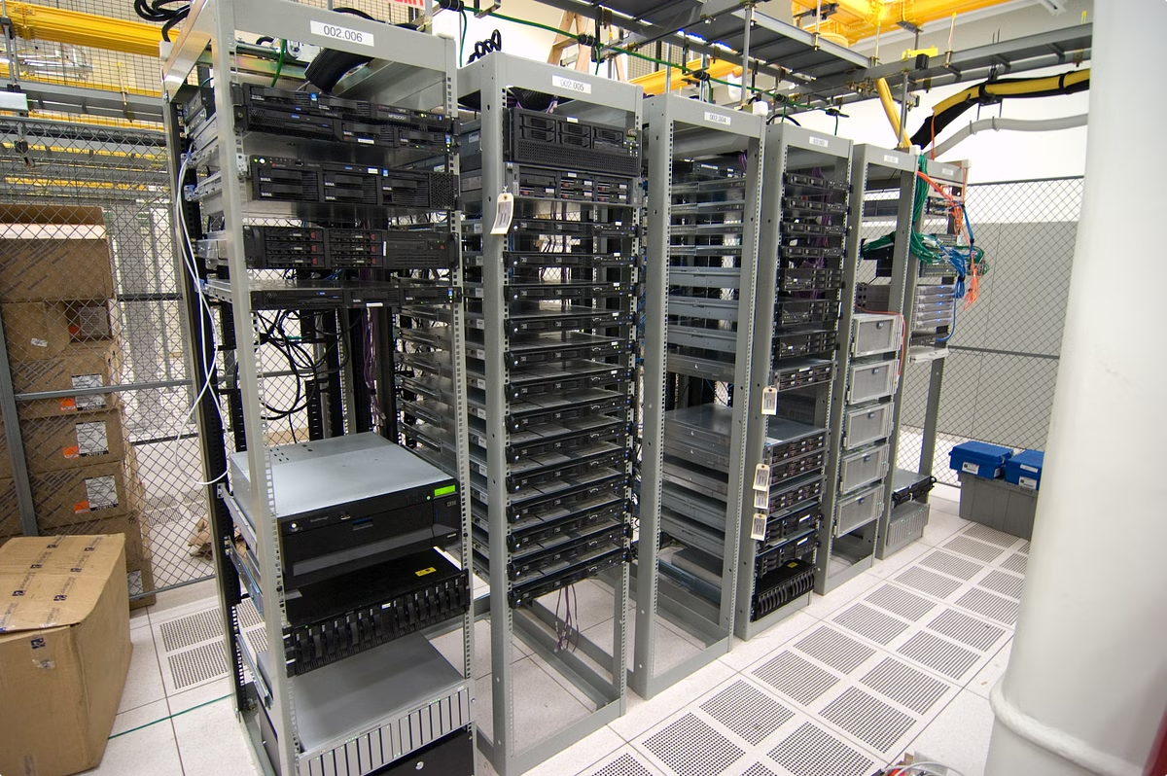




Deployment and Hosting
The deployment and hosting of our web-based job application platform involved careful planning and execution to ensure a reliable and scalable infrastructure. We selected a cloud-based hosting provider, leveraging their robust infrastructure and scalability to handle varying traffic demands and ensure continuous availability.
Cloud Hosting
Server Configuration
We opted for a cloud-based hosting platform, benefiting from its scalability, reliability, and cost-effectiveness.
We carefully configured the server environment, optimizing it for performance, security, and resource utilization.
Database Management
Network Security
We implemented a robust database management strategy to ensure data integrity, security, and efficient access.
We prioritized network security, implementing firewalls, intrusion detection systems, and secure communication protocols.

Slide 10

Challenges and Lessons Learned
Throughout the development of our web-based job application project, we encountered a variety of challenges that tested our skills and pushed us to think creatively. These challenges presented valuable learning opportunities, allowing us to refine our development process and gain valuable insights into software development best practices.
1
Data Validation and Integrity
2
Performance Optimization
Ensuring data accuracy and integrity was a constant focus, leading us to implement robust validation mechanisms and error handling strategies.
Maintaining optimal performance, especially under heavy traffic, required careful optimization of code, data structures, and server configurations.
3
Security
4
User Experience
Protecting user data and system security was a top priority, leading us to implement strong security measures and adhere to best practices.
Continually striving to enhance user experience required careful consideration of UI design, usability, and accessibility.

Slide 11

Conclusion and Future Enhancements
The development of our web-based job application project has been a rewarding journey, marked by both technical challenges and creative triumphs. The resulting platform represents a powerful tool for simplifying the job application process, benefiting both job seekers and employers. However, our journey does not end here. We envision a future where this platform evolves further, incorporating new features and functionalities to enhance its utility and user experience.
Advanced Search Features
Enhanced Profile Management
Integrated Communication Tools
Implementing advanced search filters, including keyword matching, job title matching, and location-based searches, to enhance job search capabilities.
Expanding user profile functionality to allow for more detailed profiles, showcasing skills, experience, and portfolio, for a more comprehensive representation of a candidate.
Integrating communication features, such as in-app messaging, to facilitate direct communication between job seekers and employers, streamlining the application process.

